Slide 1
Claim, evidence, and interpretation [cei]: paragraph structure to ensure you have an effective argument

Slide 2
Paragraph Structure: C.E.I
Claim: What’s your point? What are you trying to prove?
This is an assertion.
You must answer the prompt.
Use adjectives to show comprehension.
Sample Prompt: Discuss the conditions of indentured servitude and the degree to which servants were treated fairly.
Sample Claim: Indentured servitude in the 17th century colonial America established clear and fair conditions for both servant and master.
This should be one sentence long.
This includes the answer in the form of a topic sentence.

Slide 3
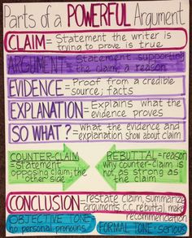
Evidence: What is your proof? Where is it from?
This is a fact or proof from a credible source (a quote).
This MUST include quotations from a credible text that prove your CLAIM.
Quotations include ANY piece of writing that is not YOUR OWN. If it’s not in your words OR if it’s not your own personal thought, place “quotations” around it.
Quotations MAY NOT always include characters speaking in dialogue.
This MUST include in-text citations.
Citations should come after your quotations and should include:
Prose: Author Last Name, Page Number
(Griffin 3)
Poetry: Line Number(s)
(3) OR if more than one (3-4)

Slide 4
Interpretation: So what?
This is your commentary or explanation.
You should explain what your evidence proves.
Must be at least TWO sentences.
This should be in your OWN words.
Do NOT use “I” or “You” in your interpretation.

Slide 5
Introduction
Your introduction introduces the reader to your topic.
It MUST contain three things:
Hook
Bridge
Thesis Statement

Slide 6
Introduction: HOOK
You must get your reader to WANT to read your essay first.
The hook contains between 1-3 sentences and MUST relate to the topic of your essay.

Slide 7
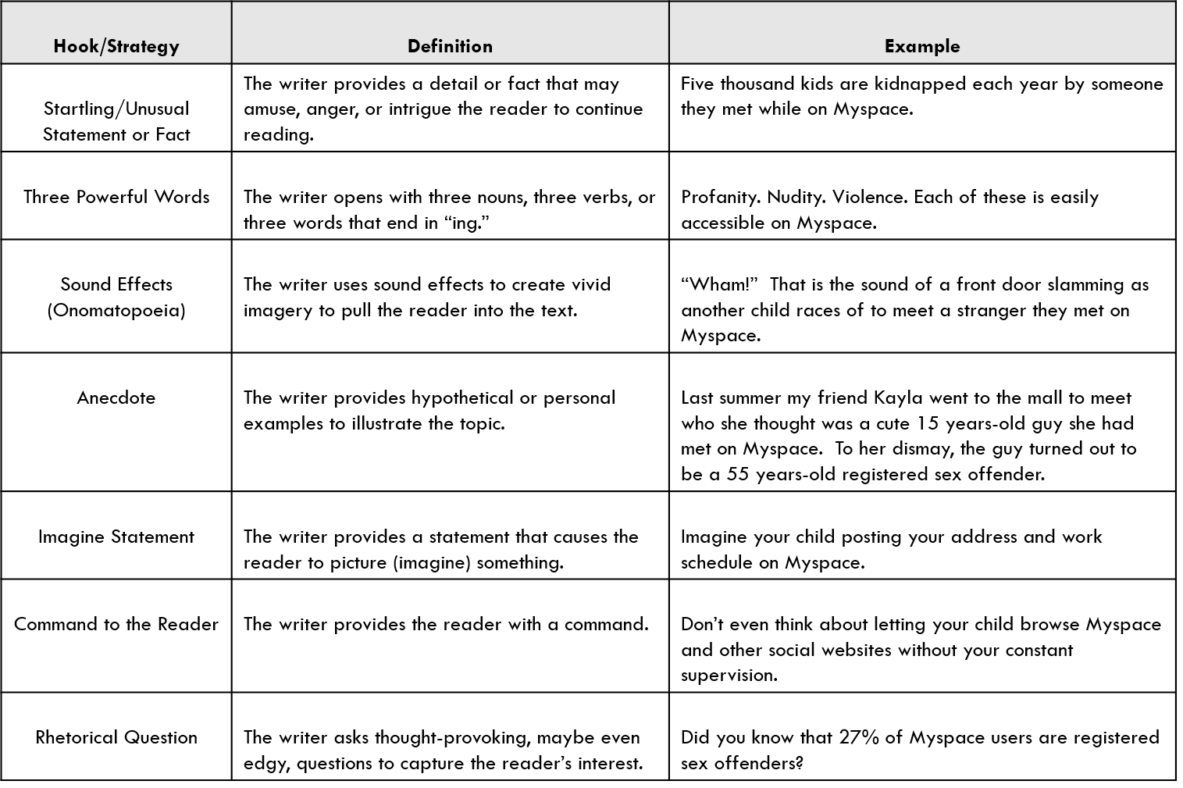
Introduction: HOOK

Slide 8
Introduction: BRIDGE
Present the necessary background to connect your hook and your thesis statement.
The Bridge ties the hook to the prompt and thesis statement while providing the reader with background information.

Slide 9
Introduction: Thesis Statement
It takes a stand rather than announces a subject.
It will NOT say: “In this paper I will…”
It will be specific with only ONE main point.
It comes at the END of the introduction.
Need help? Try using this method:
In title of text, author’s name uses concrete element to power verb abstract concept.
In The Tragedy of Julius Caesar, William Shakespeare uses strategically planted rhetorical devices to manipulate the audience’s reactions regarding the death of Julius Caesar.

Slide 10
ABSTRACT CONCEPT VS CONCRETE ELEMENT
ABSTRACT CONCEPT
CONCRETE ELEMENT
Love
Success
Moral
Good
Bad
Must be inferred by concrete elements.
Rhetorical Devices:
Something that is actually used within the piece of literature in order to create deeper meaning.
Directly in the text.

Slide 11
Introduction: Thesis Statement
Test your Thesis Statement:
Does it inspire a reader to ask: How? Why? Or want to learn more?
Would a reasonable reader not respond with “Duh!” or “So what?” or “No Kidding!”?
Does the thesis statement avoid general phrasing and/or sweeping words such as “all,” “none,” or “every”?
Does the thesis guide the reader toward the claims, or topic sentences?
Can the thesis be explained in the amount of length necessary?

Slide 12
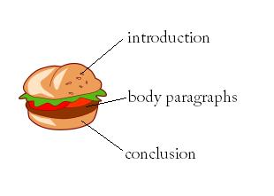
Body Paragraphs
Each of your body paragraphs MUST include
(1) Claim
(2) Evidence
(2) Interpretation
Your body paragraph will look like this:
Claim (1-2 sentences)
Evidence (1-2 sentences)
Interpretation (2-3 sentences)
Evidence (1-2 sentences)
Interpretation (2-3 sentences)

Slide 13
Conclusions
This is the easiest part of your essay and should be only 3-4 sentences.
Your conclusion should have:
(1) Topic Sentence: it is okay to start with “In conclusion,…”
(1) Restate your Thesis Statement: remind the reader of the most important ideas in the essay.
(1) Concluding Sentence: this should be STRONG. This sentence is the last sentence your reader will read. Leave an impression!
Examples of Concluding Sentences: rhetorical questions, make a prediction, or provide recommendations.

